Slide 1
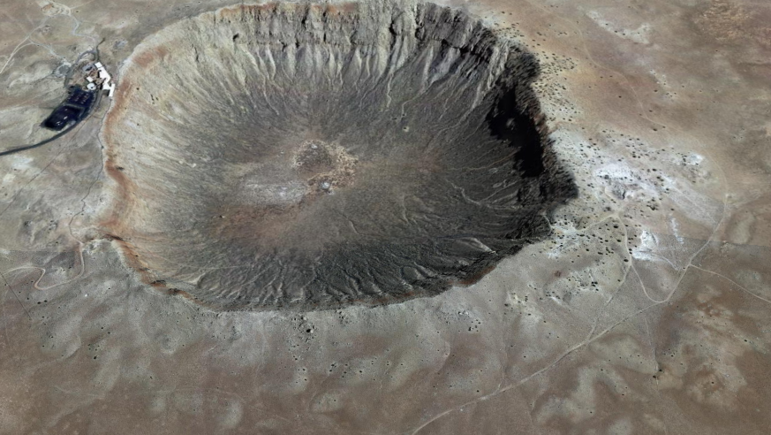
The Barringer Meteor Crater Arizona
By
Mellissa Freeman

Slide 2
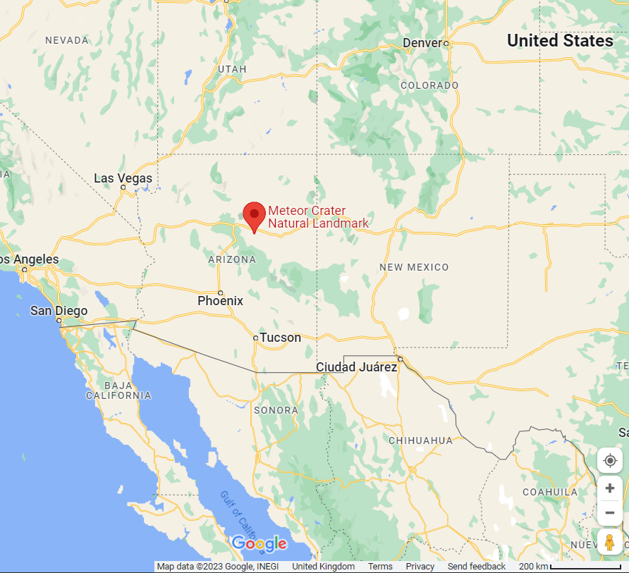
Location
Colorado Plateau

Slide 3
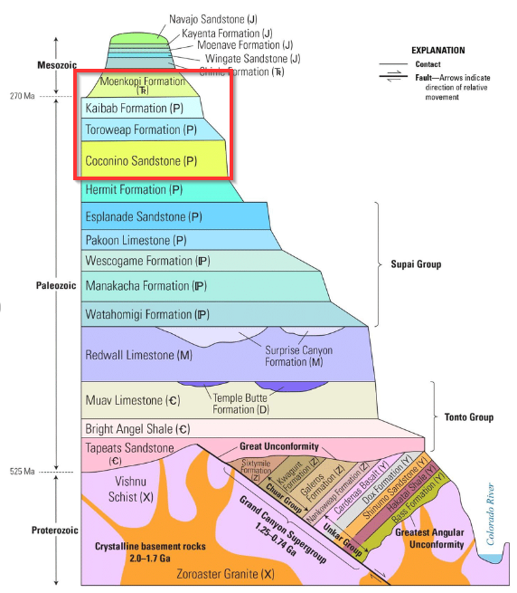
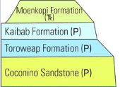
The geology

Slide 4
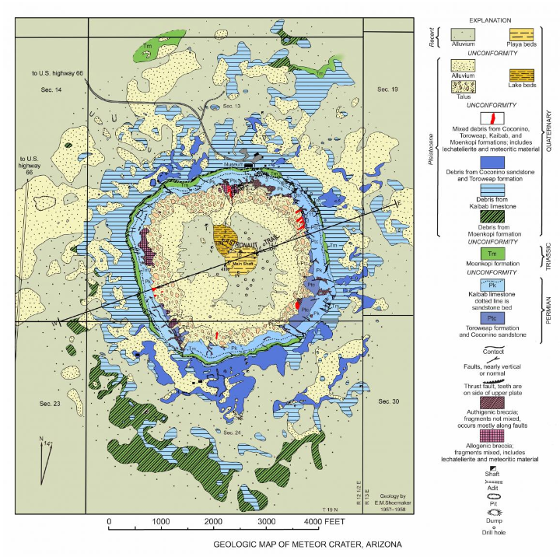
Geological Map of Meteor Crater Arizona
Created by Gene Shoemaker, 1960

Slide 5
The history
Impact happened approx. 50,000 years ago
1871 - The first written report was by a man by the name of Franklin
1886 – iron-nickel meterorites were found by a sheep herder
1891 – site visited by USGS who deemed it to be volcanic
1903 – site was purchased by Daniel Moreau Barringer
1941 – the Barringer family entered into a lease with Bar T Bar Ranch Company and formed the Meteor Crater Enterprises Inc which is still running today.

Slide 6
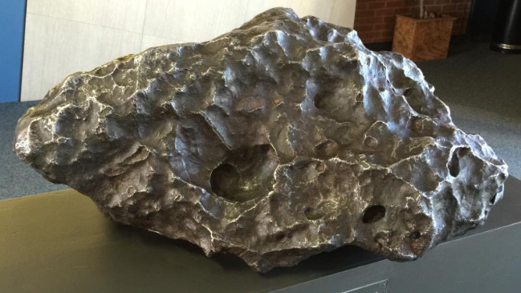

Slide 7
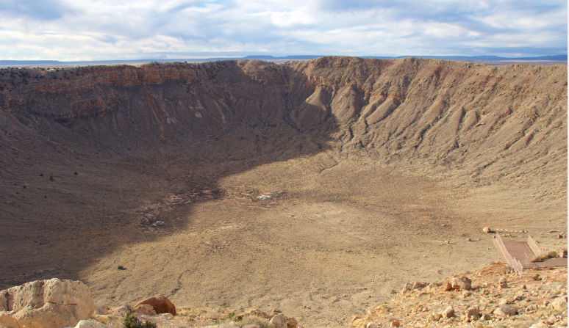

Slide 8
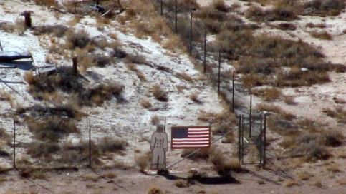

Slide 9
THE END OF PART 1….

Slide 10
A brief look at naturally occurring fission reactors
Anne Hunt

Slide 11
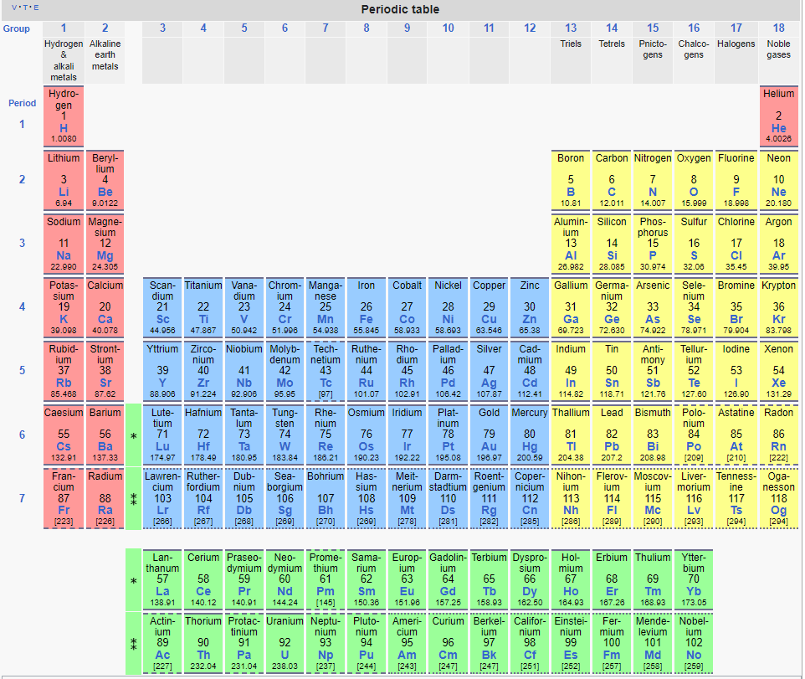
Uranium
Actinide
Atomic number 92

Slide 12
Uranium
2 isotopes
²³⁵U
²³⁸U
Both radioactive but half lives differ
²³⁵U: 700 million years
²³⁸U: 4.6 billion years
Natural relative abundance
²³⁵U: 0.72%
²³⁸U: 99.28%
Relative adundance is remarkably consistent worldwide…

Slide 13
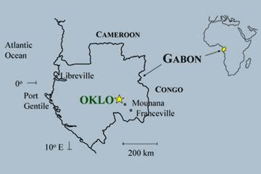
Relative abundance
…except in zones in the uranium mines at Oklo, Okelobondo and Bangombé in the Franceville Basin, Gabon
In these zones
²³⁵U is low as 0.38 %
an assembly of the end-member fission products which result from sustained nuclear reactions in a nuclear reactor

Slide 14
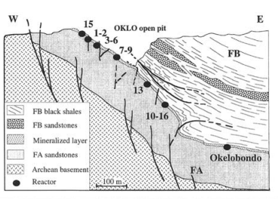
Geological setting
Uraninite deposits
located near the top of a succession of sandstones and conglomerates
Uraninite deposits
Formed by dissolution-precipitation processes
From which approximately 28,000 tonnes of uranium ore have been mined
Age: 1950 ± 40 Ma - Proterozoic
Gauthier-Lafaye et al 1996

Slide 15
Geological setting
U-bearing conglomerates
Buried by deltaic marine deposits of Upper FA formation and FB shales
U(VI) oxides
Shales were rich in organic matter
Burial at depths of up to 4 km
Temperature and pressure conditions of “oil window” causing conversion to hydrocarbons
Hydrocarbons
migrated to the FA sandstone reservoir rock
Accumulated in structural traps

Slide 16
Geological setting
Uranium mineralisation
fluids containing U(VI) oxides meet fluids bearing hydrocarbons
hydrocarbons reduce U(VI) oxides to U(IV) oxides
Uranium is precipitated as uraninite (UO₂) in the sandstone in
pores
fractures
Zones
uraninite seams are depleted in uranium but contain fission products

Slide 17
Nuclear fission
Inherently unstable nuclei of radioactive isotopes “decay” spontaneously emitting a neutron
Decay occurs more readily if provoked by disturbance of the structure of the nucleus
Most readily caused by the absorption of a neutron
Certain isotopes, termed “fissile”, will absorb a neutron
²³⁵U is fissile
²³⁸U is not fissile
²³⁵U + n = ²³⁶U

Slide 18
Nuclear fission
The fissile nucleus becomes even more unstable and splits into
2 fission nuclei
2 to 3 free neutrons travelling at high speed
⁹²Kr
²³⁶U
¹⁴¹Ba

Slide 19
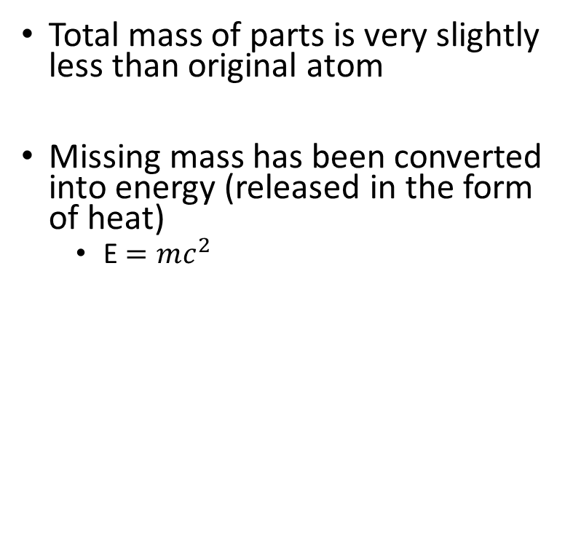
Nuclear fission
Total mass of parts is very slightly less than original atom
Missing mass has been converted into energy (released in the form of heat)
E $=mc^{2}$
⁹²Kr
²³⁶U
¹⁴¹Ba

Slide 20
Nuclear fission
These neutrons may go on to trigger fission of neighbouring fissile isotopes – a chain reaction
A chain reaction may be
Uncontrolled – runaway nuclear reaction – basis of atomic weapons or
Controlled (“moderated”) - basis of nuclear power
For a controlled nuclear reaction, neutron speed is crucial
Too fast – will go through nuclei = no neutron capture – chain reaction shuts down
Too slow – insufficient energy = no neutron capture – chain reaction shuts down
Goldilocks speed = neutron capture followed by fission

Slide 21
Nuclear fission
High speed neutrons
inelastic collisions with things of similar mass will slow down neutrons emitted by fission
In liquid form, some water molecules dissociate into hydrogen ions and oxygen ions
A hydrogen ion has the same mass as a neutron
Water is a good moderator

Slide 22
Criteria for self-sustaining chain fission reactions i.e. a nuclear reactor
Sufficient fuel
Sufficiently high ratio of ²³⁵U: ²³⁸U
Containment
Moderator

Slide 23
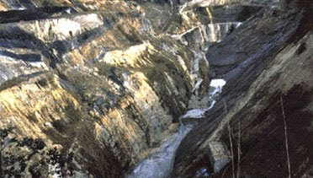
Conditions at Oklo
Sufficient fuel
U ore seams are at least 0.5 m and typically contained in layers 2m thick
Sufficient concentration of uranium-bearing minerals
Minimum requirement of 10%
In reactor zones, typically 20 to 87%
Remains of reactor at location 2

Slide 24
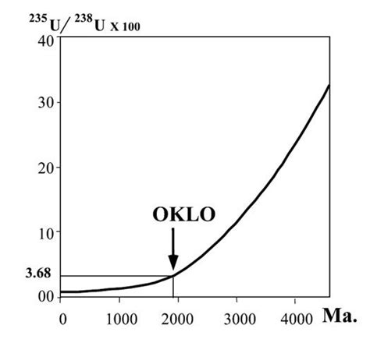
Conditions at Oklo
2. Sufficiently high ratio of ²³⁵U: ²³⁸U
Based on the half lives, extrapolation backwards to nearly 2Ga indicates that the relative abundance was approximately
U – 235: 3.68%
U – 238: 96.32%
Fuel for nuclear power plant: approximately U – 235: 3 to 5%
Gauthier-Lafaye 2002

Slide 25
Conditions at Oklo
3. Containment
Enveloped by clay minerals
e.g. illite
Quartz-rich sandstone are natural neutron reflectors
Sharp boundary between reactor zone and underlying sandstone
often with a thin layer of hematite (Fe₂O₃)
reactor zone
Uranium ore 20-87%
Upper FA sandstone
clay
hematite

Slide 26
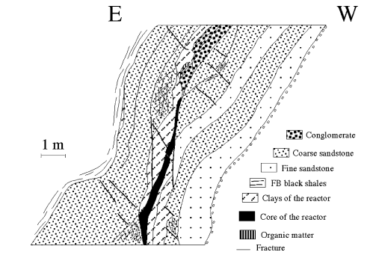
Conditions at Oklo
Moderator
Meteoric water seeping down through porous rocks and faults
Rector 9 from earlier figure Gauthier-Lafaye et al 1996

Slide 27
Duration of Oklo fission reactors
Short-term
Heat generated by the fission reactions caused the water to boil away
Without a moderator, the chain reactions shut down
When cooled sufficiently for water to flow back, neutron speed is moderated again and chain reactions recommence
Calculations indicate
Activity – approximately 30 minutes
Shut down – approximately 2 hours 30 minutes
i.e. a 3 hour cycle
Long-term
Differs between reactor sites – approximate range 62,000 to 270,000 years
Analyses of abundances of fission products

Slide 28
Depleted Uranium
Research into current conditions at Oklo - useful analogue in connection with disposal of nuclear fuels

Slide 29
References
A. P. Meshik, C. M. Hohenberg, and O. V. Pravdivtseva "Record of Cycling Operation of the Natural Nuclear Reactor in the Oklo/Okelobondo Area in Gabon," Phys. Rev. Lett. 93, 182302 (2004).
Janeczek, J. Mineralogy and Geochemistry of Natural Fission Reactors in Gabon. Reviews in Mineralogy Volume 38 p.321
Meshik, A. P. (November 2005). "The Workings of an Ancient Nuclear Reactor". Scientific American. 293 (5): 82–6, 88, 90–1. Bibcode:2005SciAm.293e..82M. doi:10.1038/scientificamerican1105-82. PMID 16318030.
Gauthier-Lafaye, F.; Holliger, P.; Blanc, P.-L. (1996). "Natural fission reactors in the Franceville Basin, Gabon: a review of the conditions and results of a "critical event" in a geologic system". Geochimica et Cosmochimica Acta. 60 (25): 4831–4852. Bibcode:1996GeCoA..60.4831G. doi:10.1016/S0016-7037(96)00245-1.
Davis, E. D.; Gould, C. R.; Sharapov, E. I. (2014). "Oklo reactors and implications for nuclear science". International Journal of Modern Physics E. 23 (4): 1430007–236. arXiv:1404.4948. Bibcode:2014IJMPE..2330007D. doi:10.1142/S0218301314300070. ISSN 0218-3013. S2CID 118394767.
Gauthier-Lafaye, F. (2002). "2 billion year old natural analogs for nuclear waste disposal: the natural nuclear fission reactors in Gabon (Africa)". Comptes Rendus Physique. 3 (7–8): 839–849. Bibcode:2002CRPhy...3..839G. doi:10.1016/S1631-0705(02)01351-8.

Slide 30
THE END OF PART 2…..

Slide 31
Burnham Beeches Hydrology
Bath Geological Society
Graham Hickman
May 2023
Notes:
Geology
Hydrology the basics
Hydrology monitoring timeline
Hydrology survey results
Future
Request for volunteers

Slide 32
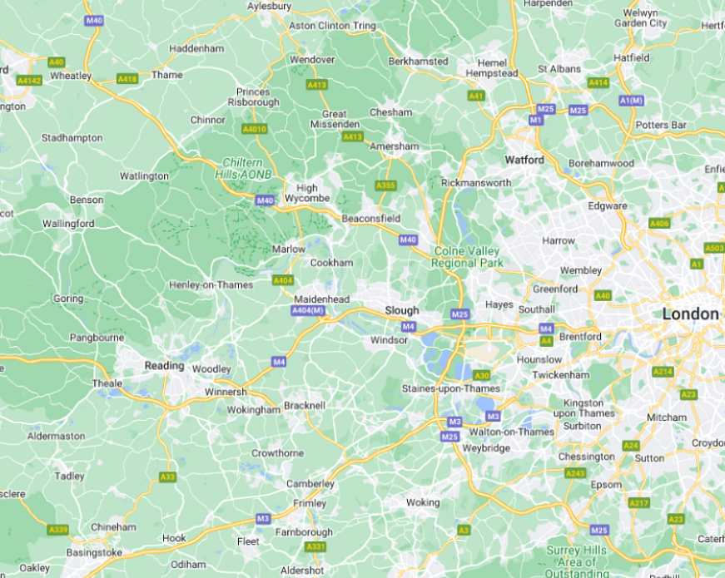

Burnham Beeches – 25miles west of London
Chilterns – Chalk escarpment
River Thames
Northern Edge of Thames Valley, Western Edge of London Basin
Notes:
Burnham Beeches is located in the southern part of Buckinghamshire, about 25miles west of London.
It sits on the northern edge of the Thames Valley – where there are a series of relic ‘palaeo-Thames’ river terraces.
And the western edge of the London Basin. Just past the outcrop limit of the London Clay
To the north west are the Chilterns, a Chalk escarpment. The chalk has a gentle SE dip below London and occurs at shallow depths below Burnham Beeches.

Slide 33
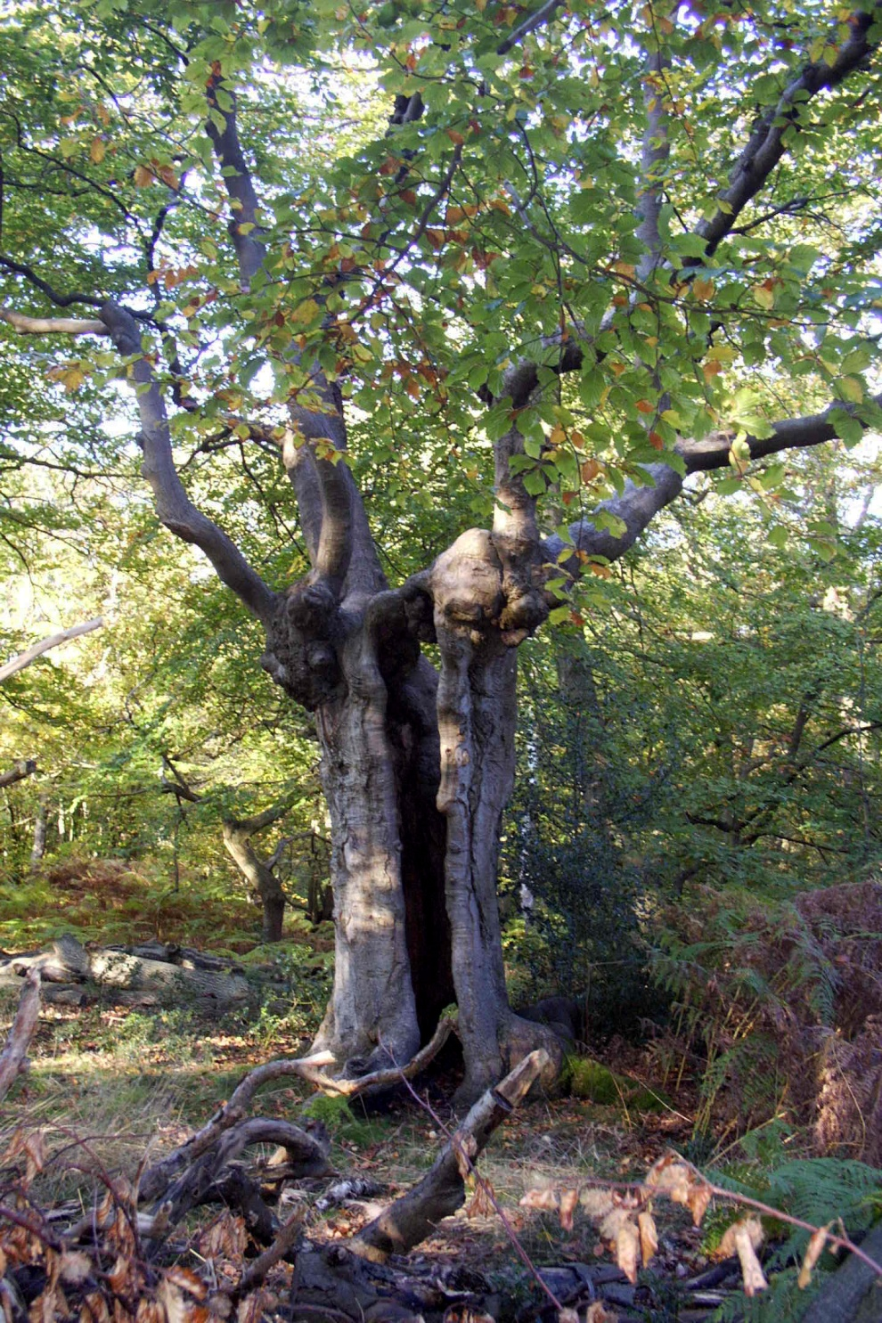
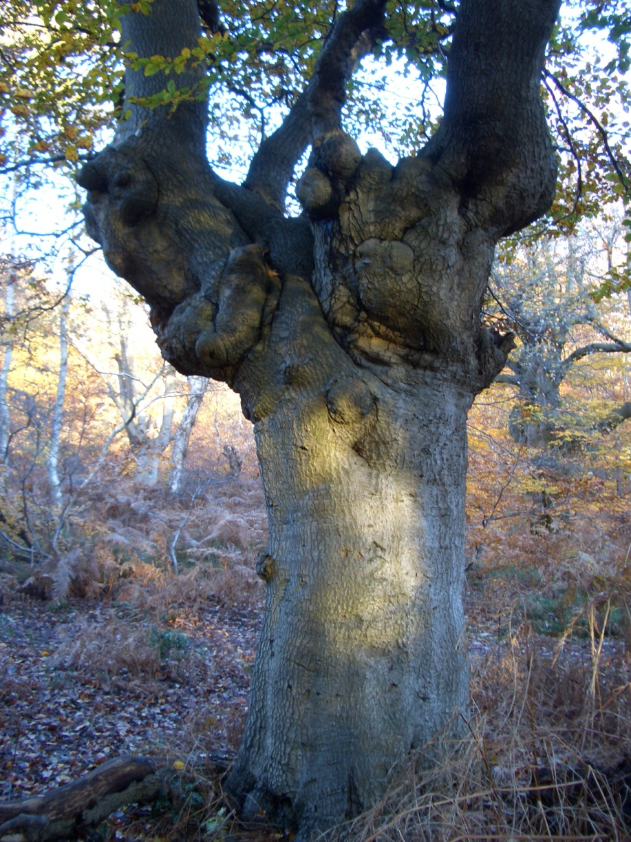
Ancient Beech Pollards – SSSI, thin sandy soils
Notes:
Burnham Beeches is a SSSI nature reserve famous for its old Pollard Beech trees.
1086 – mentioned in Domesday book as having woodland enough to feed 600 swine
1879 – put up for sale ‘land suitable for erection of superior residences’.
1880 – Campaign by Francis Heath. Corporation of London purchases under (Open Spaces Act)

Slide 34
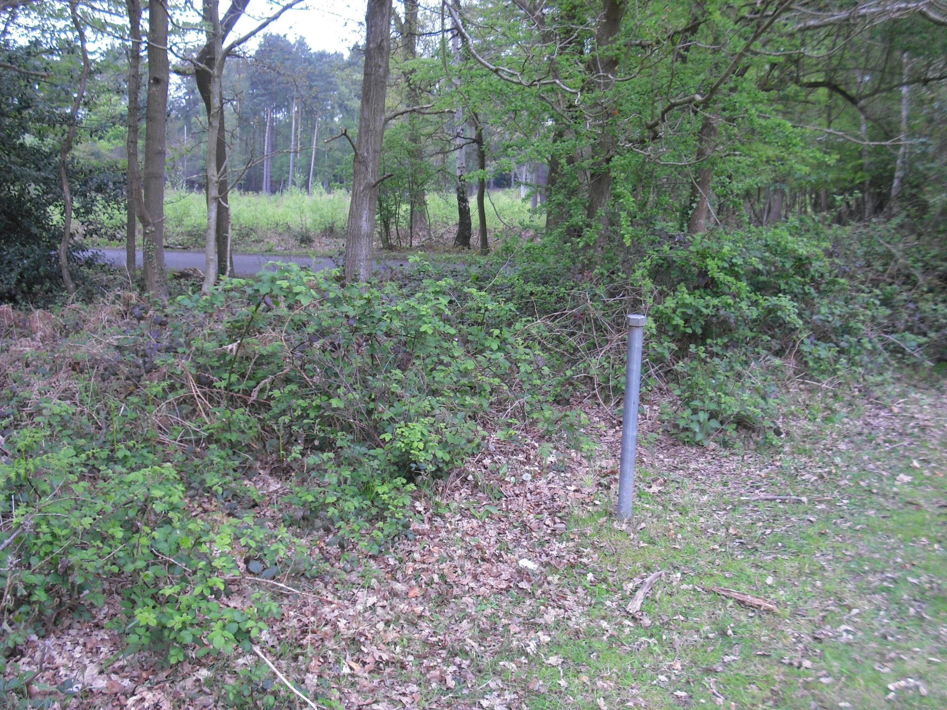
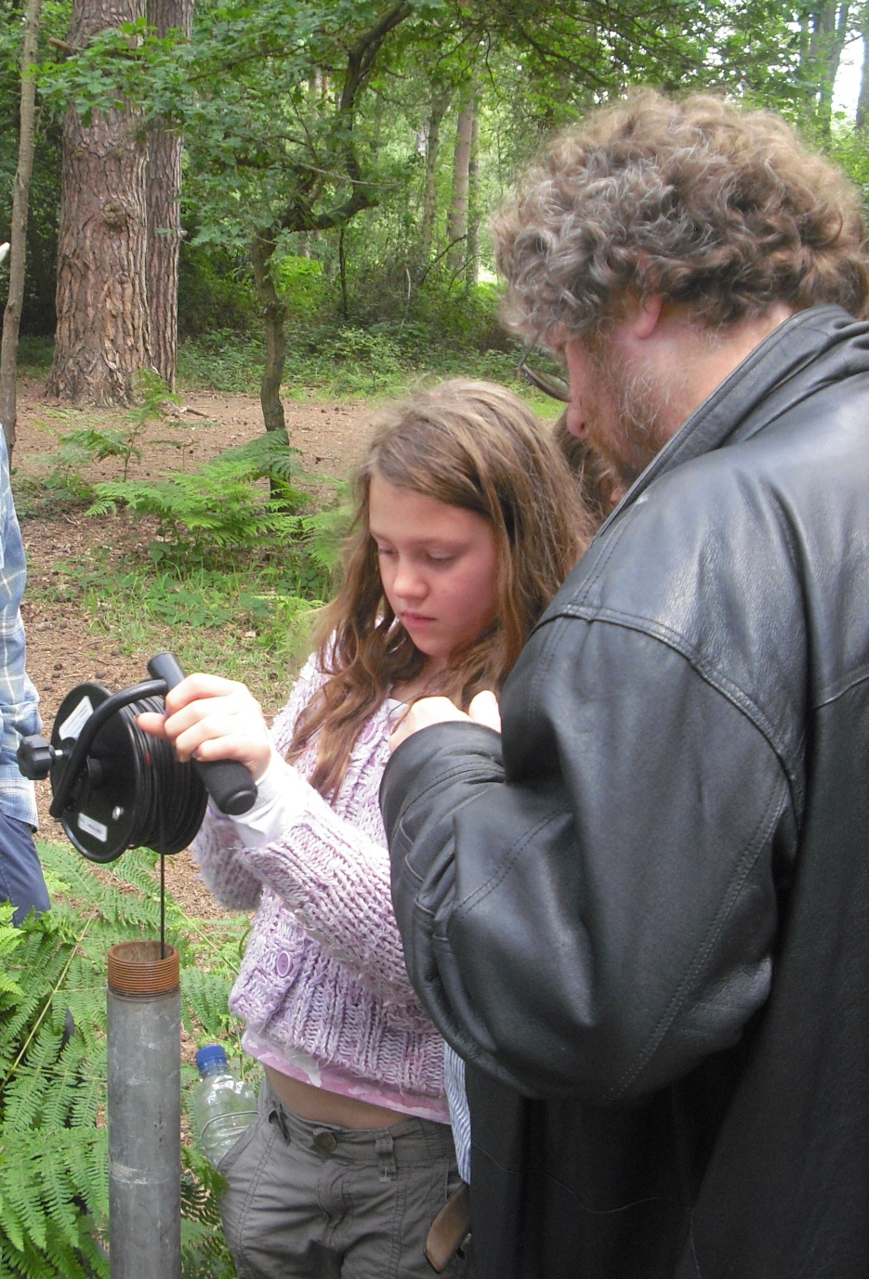
Water observation bore holes
Water Observation
borehole BB32
Sir Henry Peak’s Drive
Notes:
Burnham Beeches is about 400acres and si very popular with dog walkers and hikers
Around the site the keen observer will see a number of steel pipes sticking out of the ground.
At depth the casing have slots to allow ground water to enter the bore hole
The free water level of the ground water can be measured using a water level dip meter.
The cable has markings like a tape measure and a buzzer is sounded when the sensor connects with water.

Slide 35
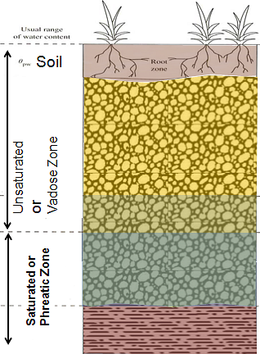
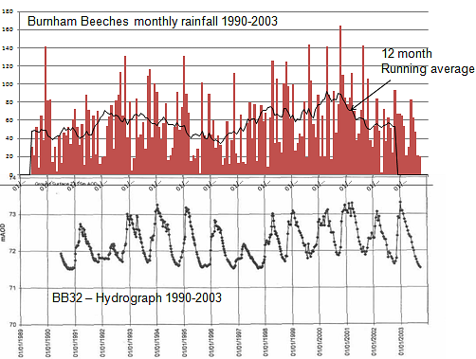
Hydrology the Basics
Water table
During summer – less rain, more evaporation, take-up by plants – water levels fall
During winter – more rain, less evaporation, reduced plant take-up – water levels rise
more run-off, bogy areas and springs more active
Notes:
Water table is top of the Saturated zone – pore spaces filled
Formal terminology
A more formal term is rest water level (RWL) which implies the water level in a borehole that has not been recently pumped, nor affected by nearby pumping. A pumped water level (PWL) refers to a water level measured while the borehole is pumped. Strictly speaking the water table refers only to unconfined aquifers; aquifers in which water is free to drain vertically from the ground surface to the aquifer. In an unconfined aquifer the groundwater may be in hydraulic continuity with surface water, in which case the surface water can be considered to be an outcrop of groundwater. However levels in an aquifer may be lower than levels in a river, in which case water may be lost from the river to the aquifer, or higher, in which case the river will gain water from the aquifer. Often rivers will gain during summer and lose water in winter.
Ground water risers and falls during the year based on a number of things
During summer – less rain, more evaporation, take-up by plants – water levels fall
During winter – more rain, less evaporation, reduced plant take-up – water levels rise
more run-off, bogy areas and springs more active

Slide 36
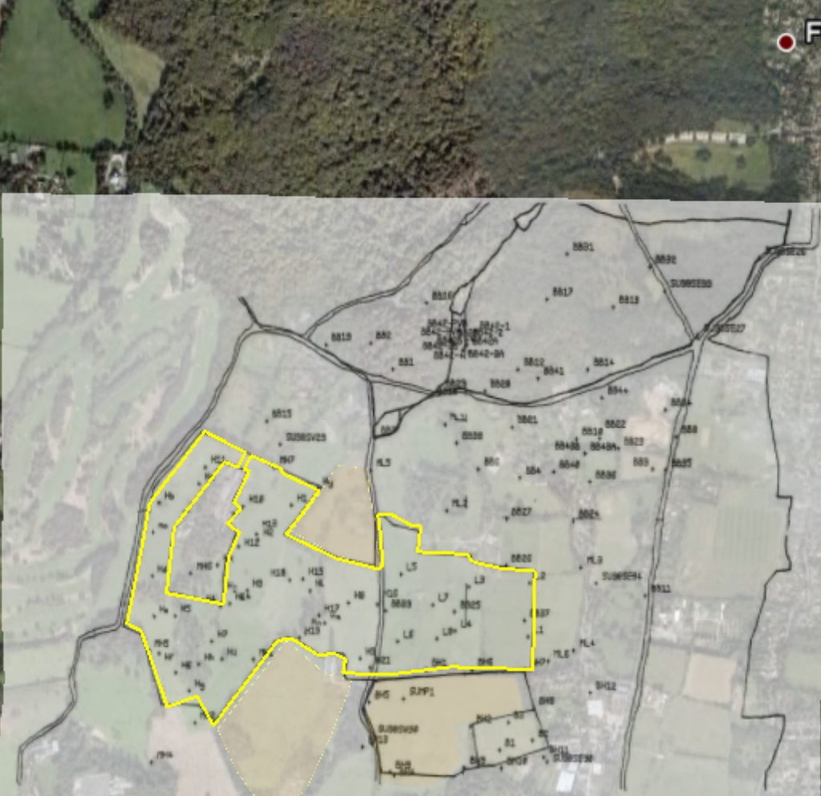
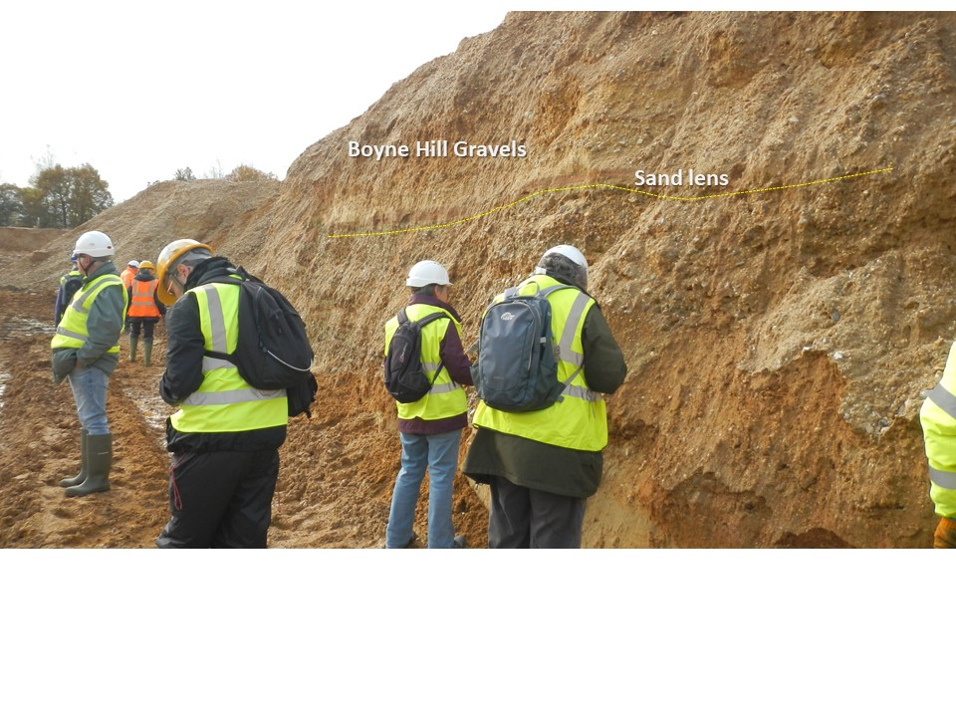

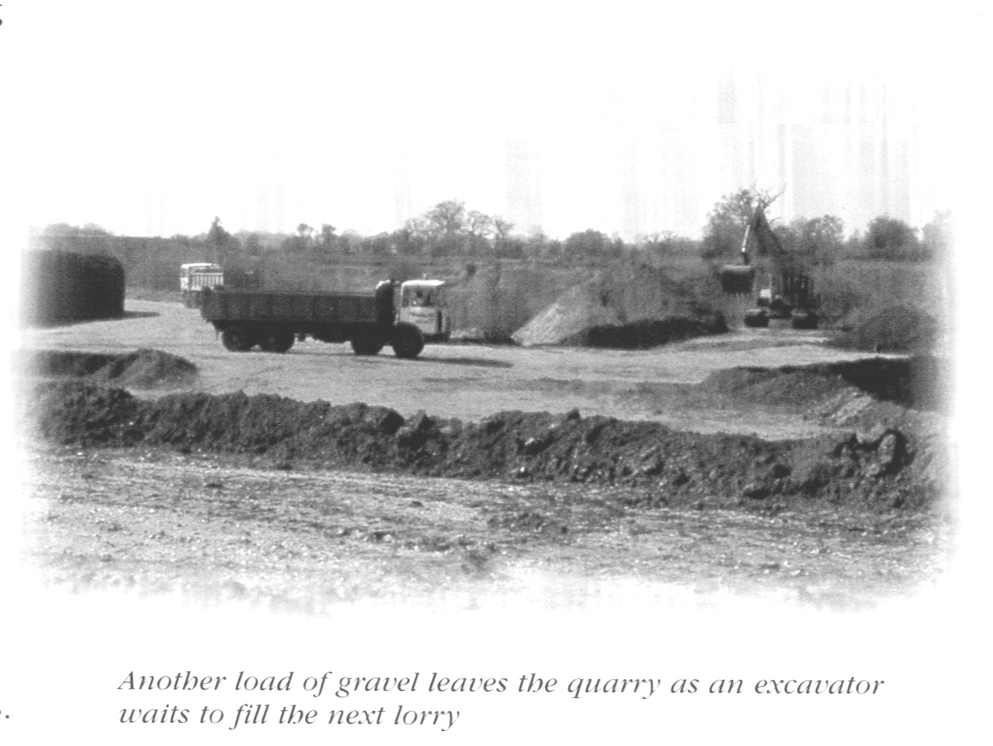
East Burnham Quarry
Despite strong opposition, in 1982 permission was given to extract gravels from a lower Terrace (Boyn Hill) south of Burnham Beeches.
Concerns about impact on Burnham Beeches by lowering water table. If a hydraulic connection exists. In 1988 this resulted in a program of boreholes being drilled and monitored.
Burnham Beeches
Phase 2
Hunts Wood
Farm
Phase 3
Leys Farm
Phase 1
Phase 1 – 1996-2006
Notes:
Hydrology / Gravel permit
1982 permit to extract gravels approved from 10 acre site. Exhausted, waste filled and sealed by 1988.
July 1988 application to extract gravel from a 52 acre site known as East Burnham Quarry. Ahead of new Environmental Assessment Regulations.
1988 Concerns about impact on Burnham Beeches by lowering water table. If a hydraulic connection exists. Nov 1988 Institute of Hydrology boreholes BB1-BB19 preliminary site investigation.
1989 Houses of Parliament Debate
1990 Boreholes BB20-BB44 drilled + Applicant boreholes (total =199 ). Readings of the ground water table begin on a weekly or fortnightly basis.
1991 Public Inquiry held. Permission granted 1992, on appeal, to extract sand and gravel, and to refill with inert waste, provided Operator establishes hydrological monitoring and remediates if adverse conditions occur. Baseline surveys continue: plus dust quantity, lichen growth and traffic numbers.
1996-2001 Phase 1 gravel extraction & fill
1999 Institute of Hydrology boreholes BB45-BB49 drilled

Slide 37
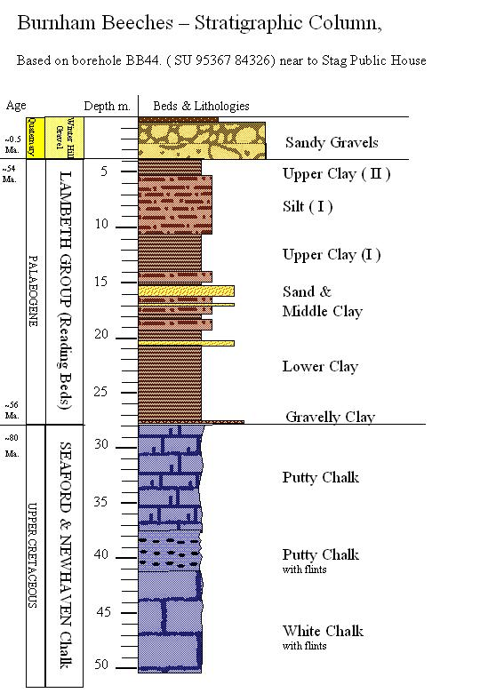
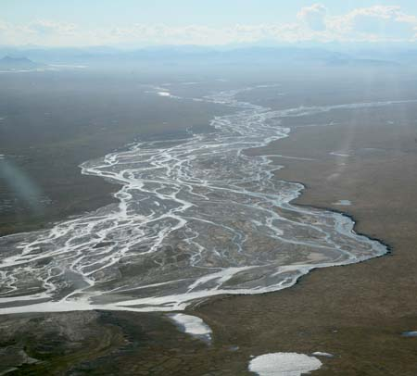
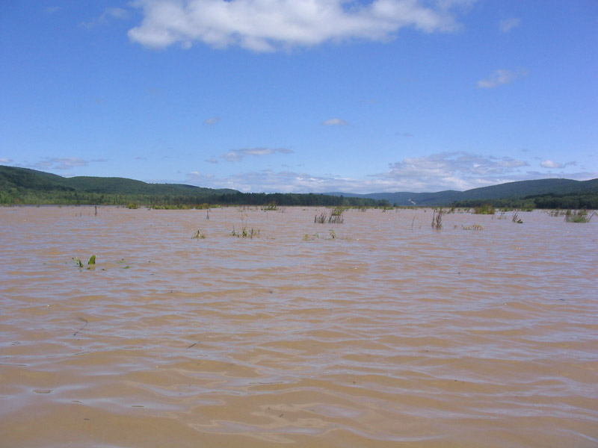
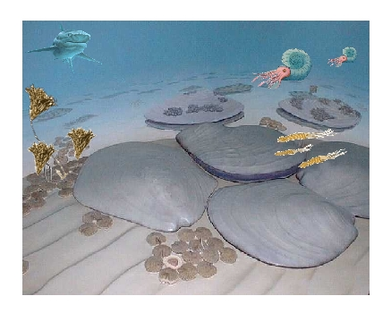
Winterhill Terrace
Quaternary ~0.45Ma
Lambeth Group
Palaeocene 56-54Ma
Chalk – Upper Cretaceous ~80Ma
Notes:
Geological stratigraphy.
Based in Bore hole BB44. around 50m deep.
Chalk – upper Cretaceous 80Ma. Marine
Palaeocene - Lambeth Group – Estuarine – 56-54Ma
Gravels – Quaternary – Ice age river terraces. 0.45Ma

Slide 38



Burnham Beeches hydrological summary
WHG
perched
SPRING
Lambeth
unsaturated
SINK
perched
perched
SPRING
SINK HOLE
DRY VALLEY
unsaturated
STREAM
Chalk
unsaturated
Water table

Slide 39
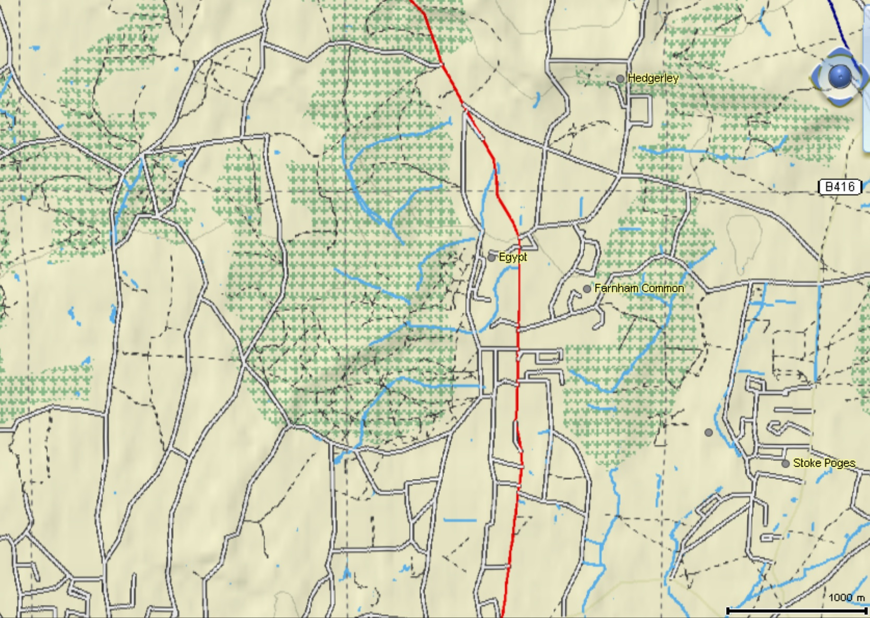
Streams in and around Burnham Beeches
Notes:
Hydrology
The hydrology of the site is extremely complex. A detailed survey was carried out by the
Institute of Hydrology to provide information for the public inquiry, held in 1991, on the
application to extract gravel from a site in East Burnham. The report is held in the Burnham
Beeches Office.
Readings of the ground water table are taken, on a weekly or fortnightly basis, for 36 bore
holes on the southern part of the site as part of the monitoring network set up to record any
effects of the gravel extraction. These were originally started by the Institute of Hydrology
and have been continued since 1991.

Slide 40
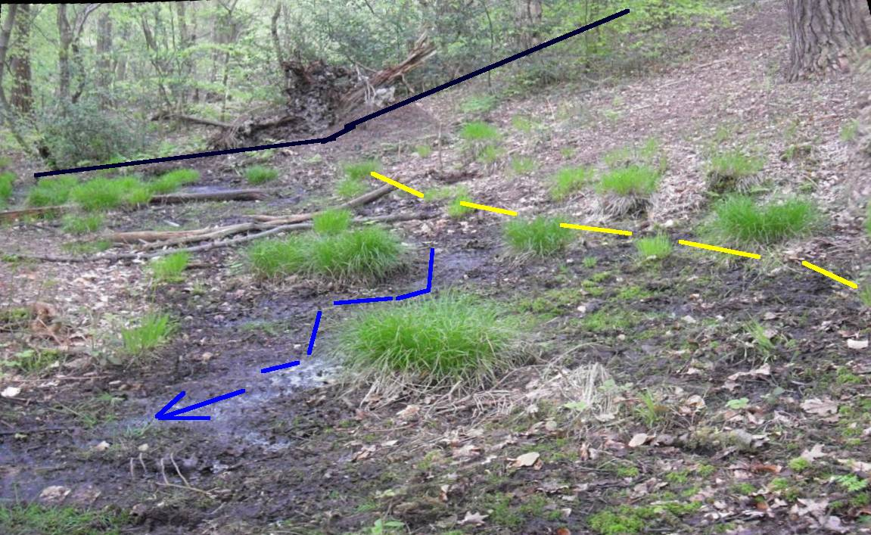
Springs develop at interface between gravels and clays, notice also break in slope
Notes:
Springs develop at interface between gravels and clays, notice also break in slope

Slide 41
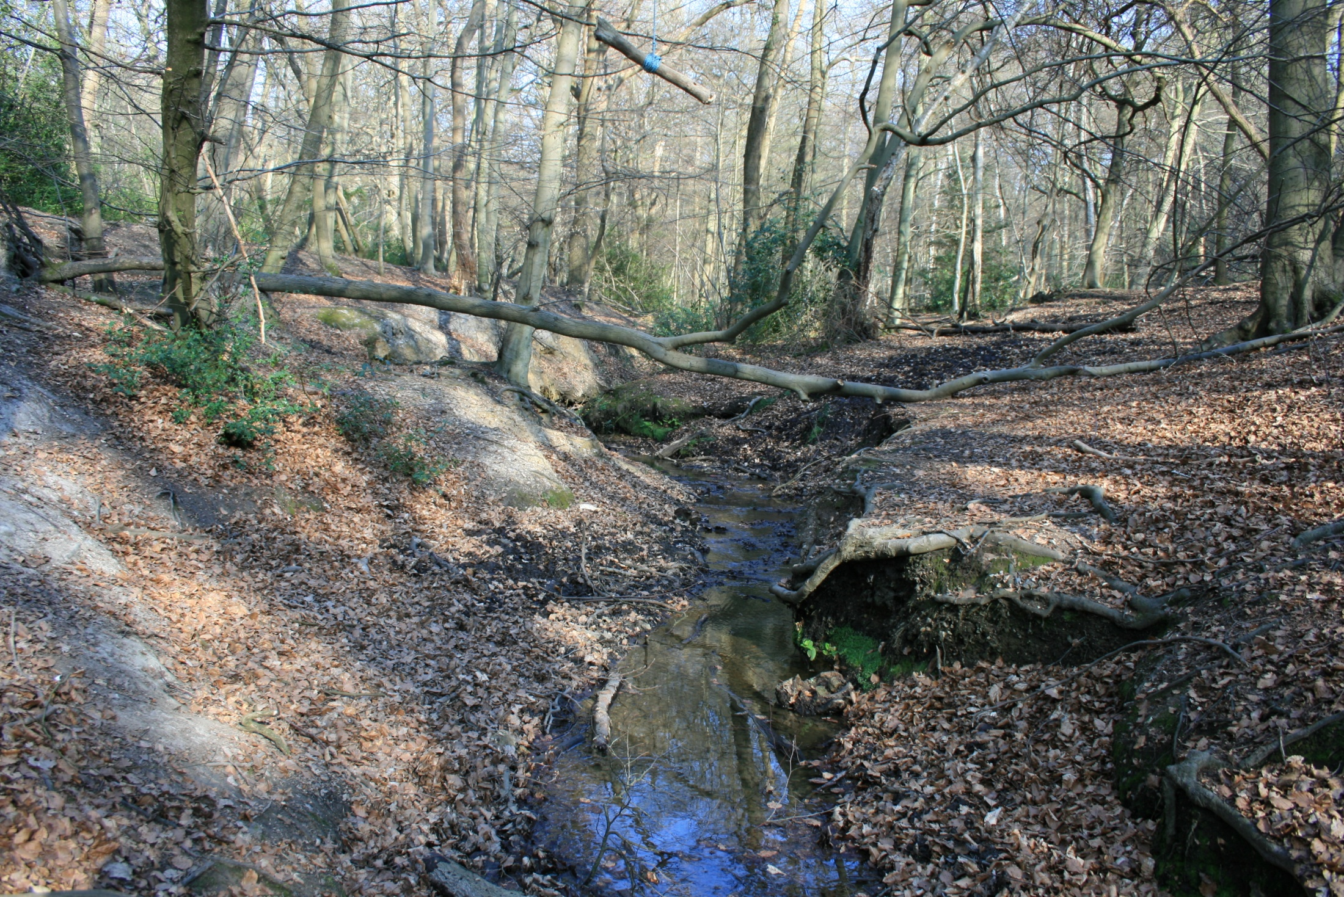
Clays and silts – springs, mires, streams.
Notes:
Over the Clays and silts – the springs run, mires form, and streams occur.
Definitions:
A perennial stream or spring has continuous flow all year round during years of normal rainfall.
An "intermittent" stream or spring normally cease flowing for weeks or months each year.
An "ephemeral" stream or spring that flow only for hours or days following rainfall.

Slide 42
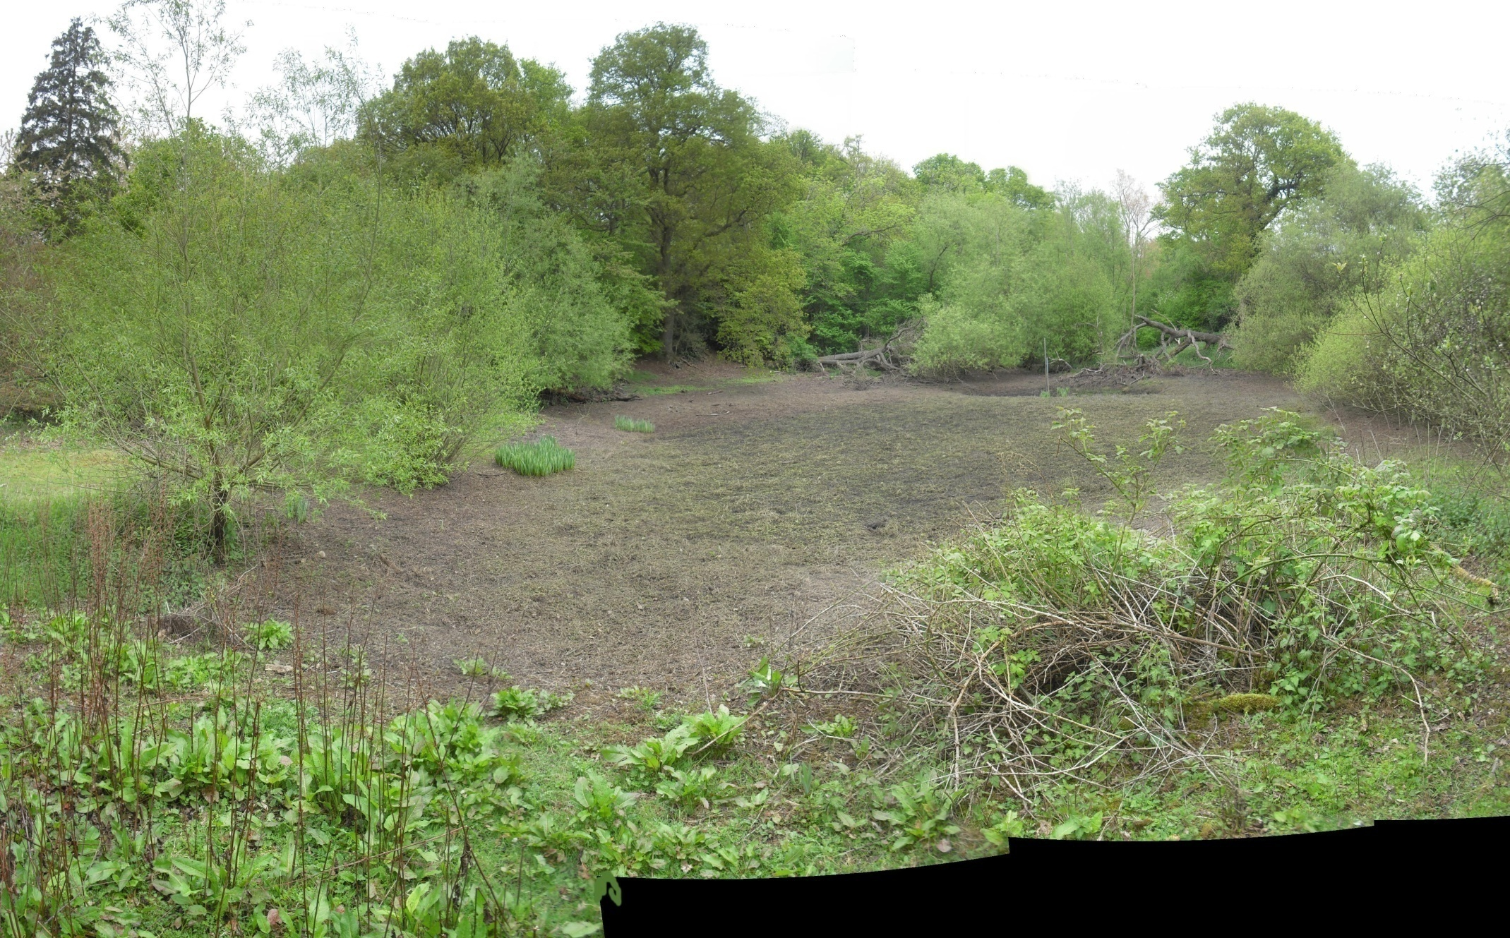
Swilly Pond May 9th 2010
Swilly Pond -May 9th 2010
Notes:
When the stream reaches the chalk its flow stops and it sinks into the ground.
Here is the Swilly pond in summer

Slide 43
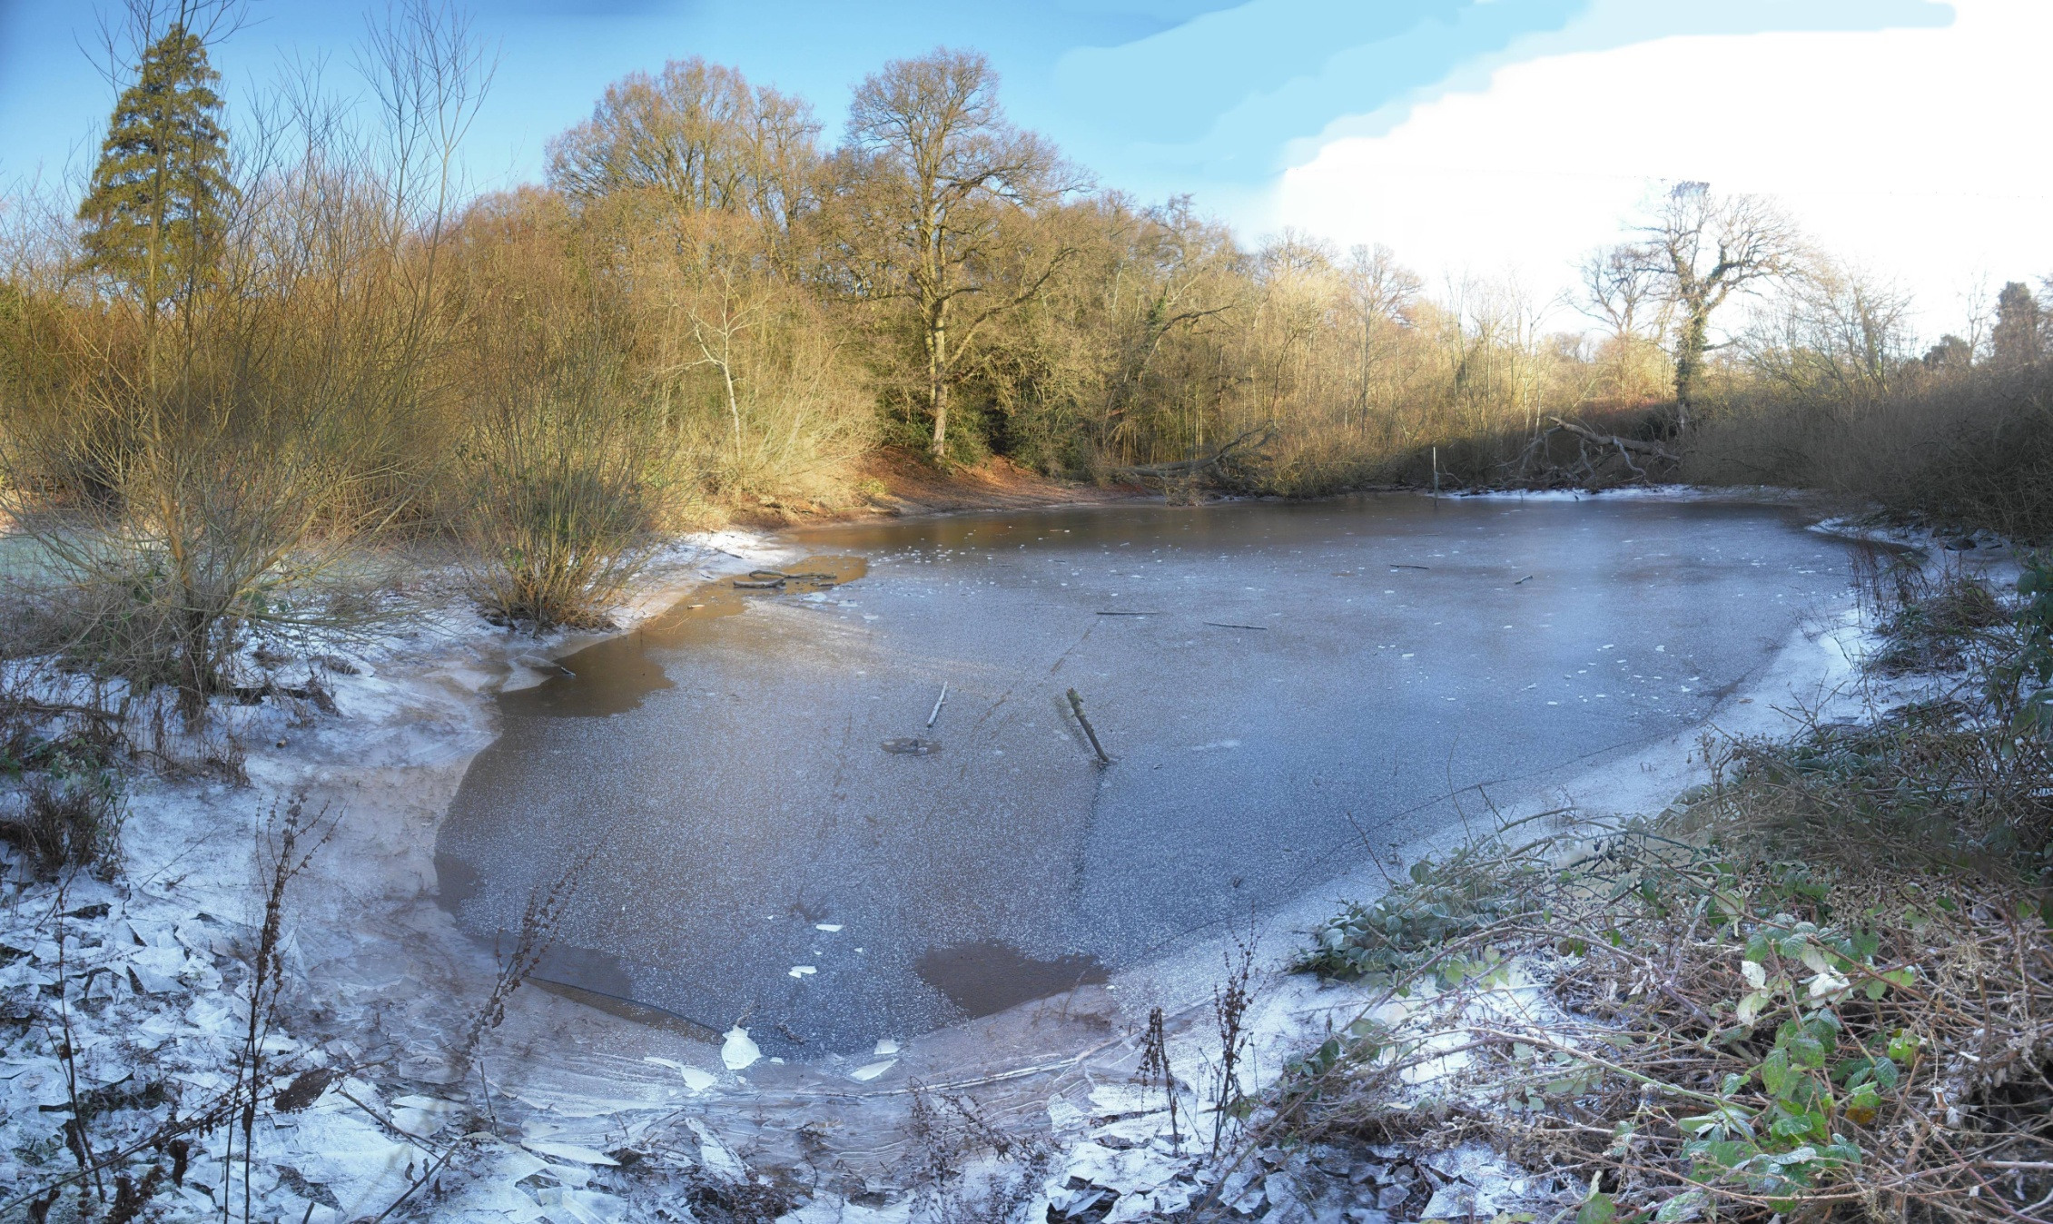
Swilly pond Jan 3rd 2010
Swilly Pond -Jan 3rd 2010
Notes:
When the stream reaches the chalk its flow stops and it sinks into the ground.
Here is the same view in winter when the water table is higher and the rainfall greater.

Slide 44
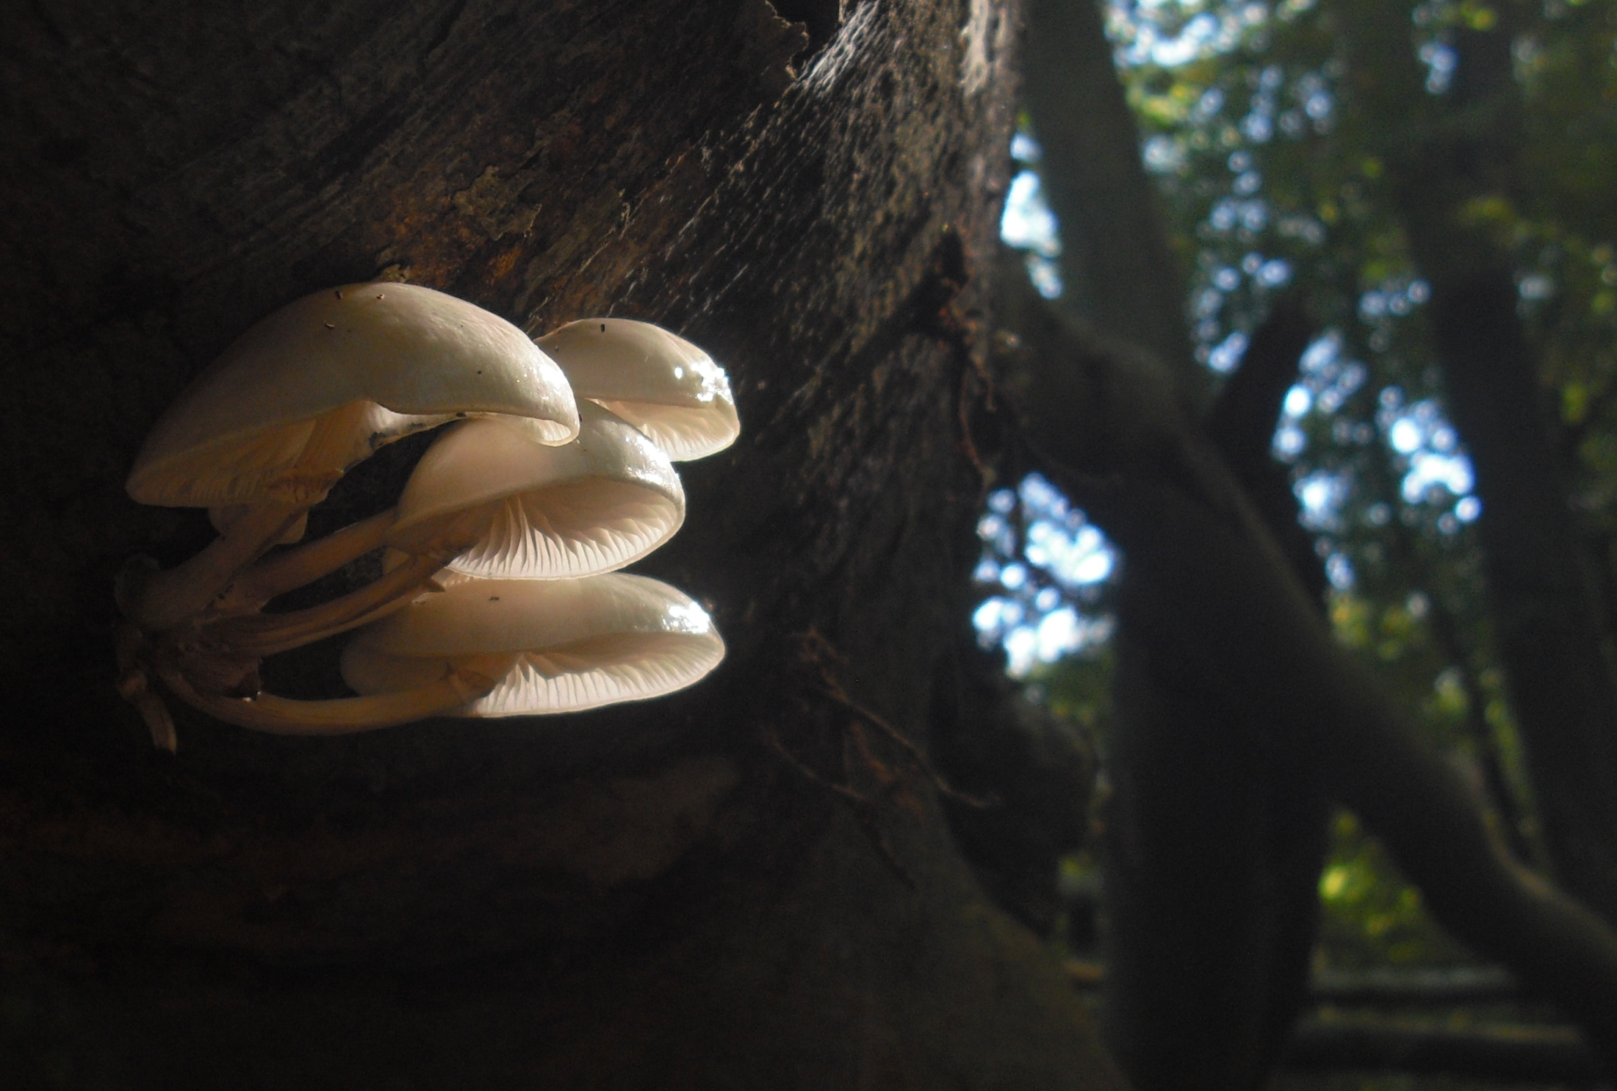
Thank you !
I hope this talk has inspired you to visit

Slide 45
THE END OF PART 3…..

Slide 46

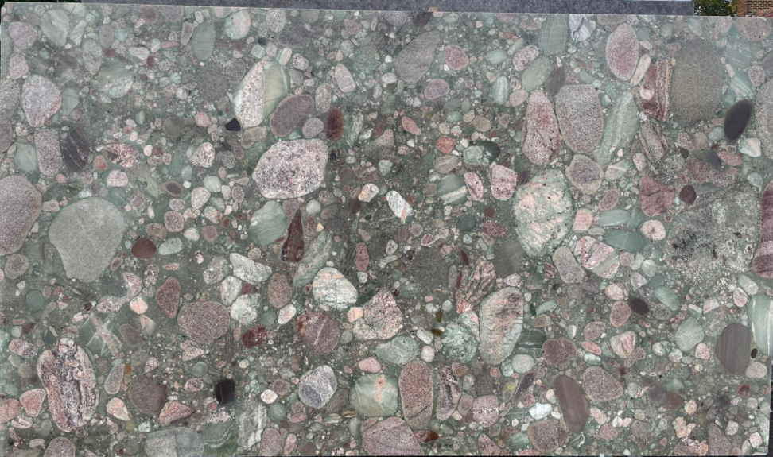
A Bit of Brazil In Bath
Bath Christmas Social 2021 (Geology of Kitchen Worktops).
Star of The Show….
Paleoproterozoic polymict metaconglomerate (Eastern Brazil)
On public display in Bath…..
0
1m
(Verde Marinace)

Slide 47
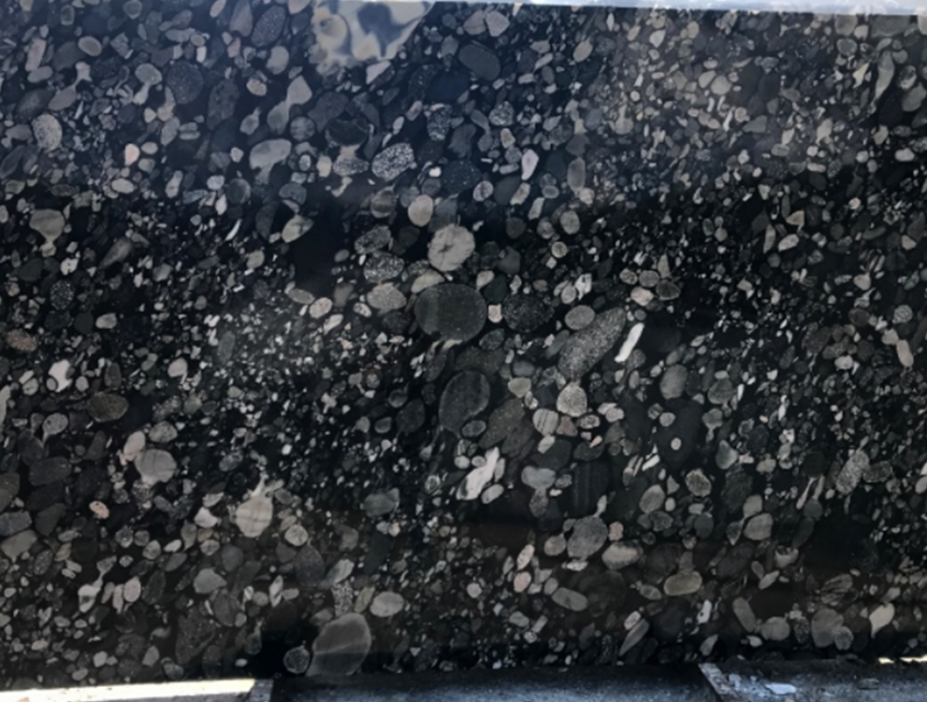
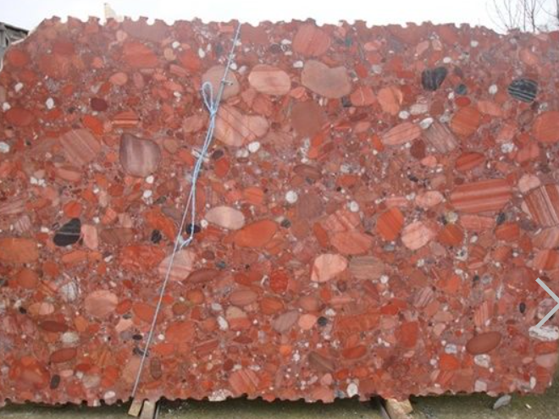
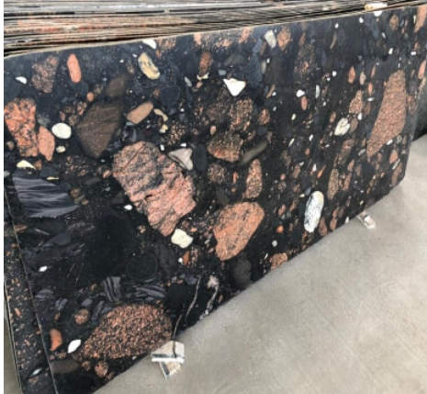
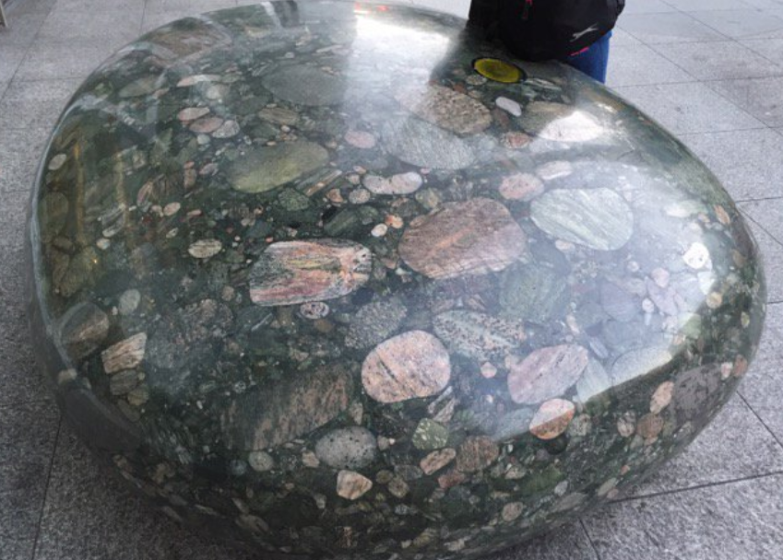
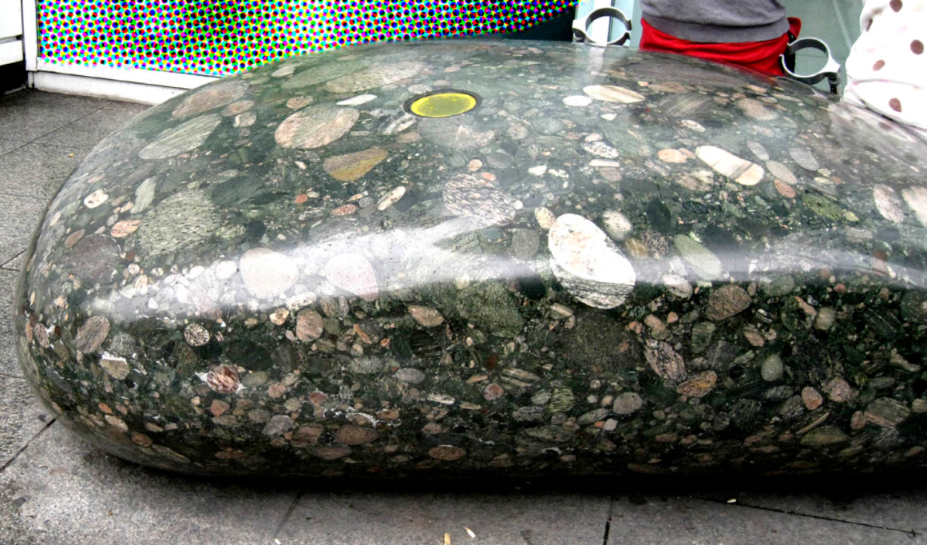
Varieties…
(Negro Marinace)
(Rosso Marinace)
(Mixed)
University College Hospital London (Monolith and Shadow sculpture by John Aitken)

Slide 48
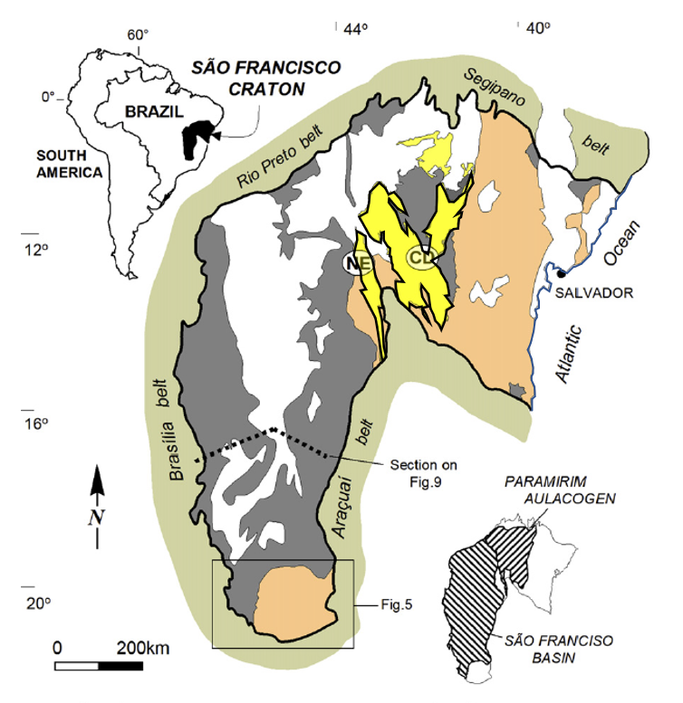
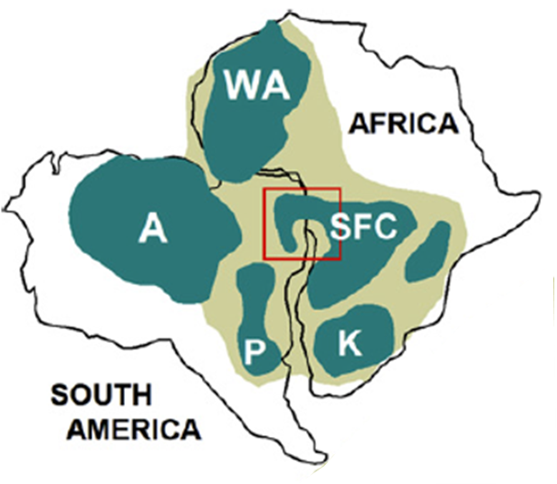




Geological Context
Phanerozoic Cover
Phanerozoic Cover
Late Neoproterozoic (Pan-African Orogeny)
Pan-African Orogenic Belt (Neoproterozoic)
Early –Mid Neoproterozoic
Cratons (Archean – Paleoproterozoic)
Paleo – Mesoproterozoic
Archaen Basement

Slide 49
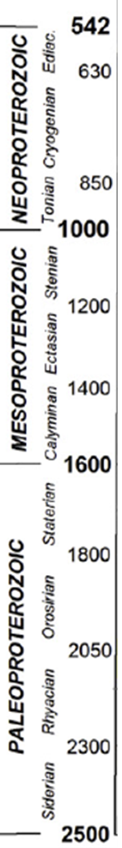

Sao Franciso Craton : Precambrian Sequence (simplified)
Pan African
Marinoan 630 - 660
Glaciation (“snowball earth”)
Sturtian 660 - 720
Neo…
Rifting
(Meta)-Sediments
Carbonates
Meso…
Rifting
Pelites
Proterozoic
Clastics / Quartzites
Rifting
Worktops!
Conglomerates & Diamictites
Banded Ironstones
Paleo…
Rhyacian / Trans-Amazonian
Igneous / (Meta)-Volcanic
Glaciation (Makganyene)
Great Oxidation Event
Basic Intrusion
Acid Volcanics
Basic Volcanics
Rio Das Velhas / Mamona
Granitoid Gneisses
Archean
3000
+
+
+
+
+
+
+
+
Granite Intrusion
+
+
+
+
+
+
+
+
+
Proto micro-continent
+
+
+
Pan African
Orogeny
3500

Slide 50
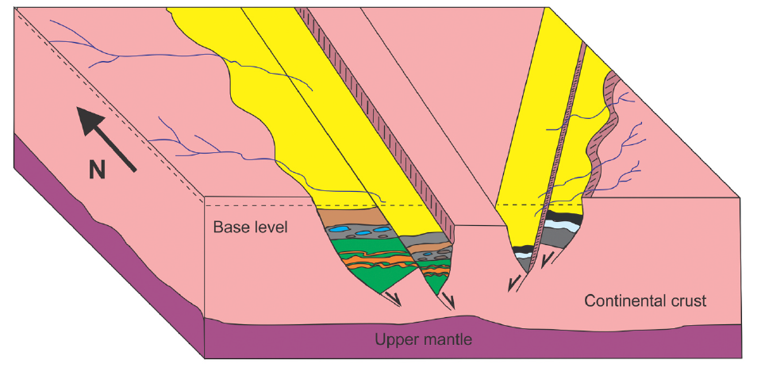
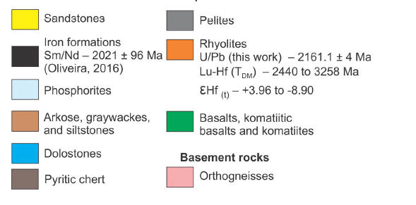
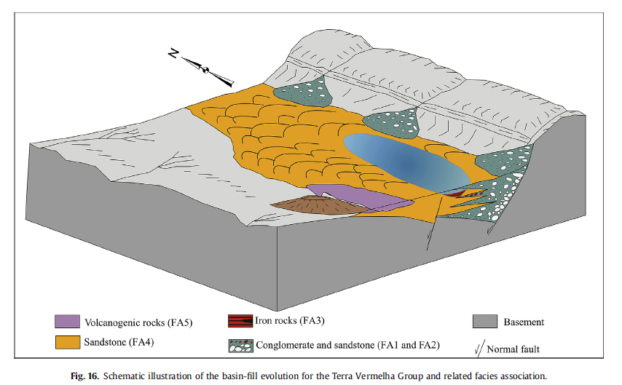
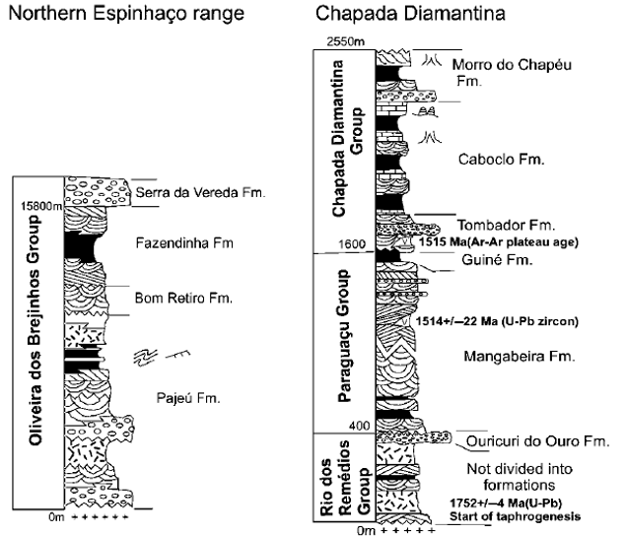
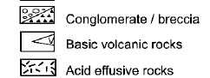
Paleoproterozoic Rift Geometries (schematic)
100-130m
50m
100m

Slide 51
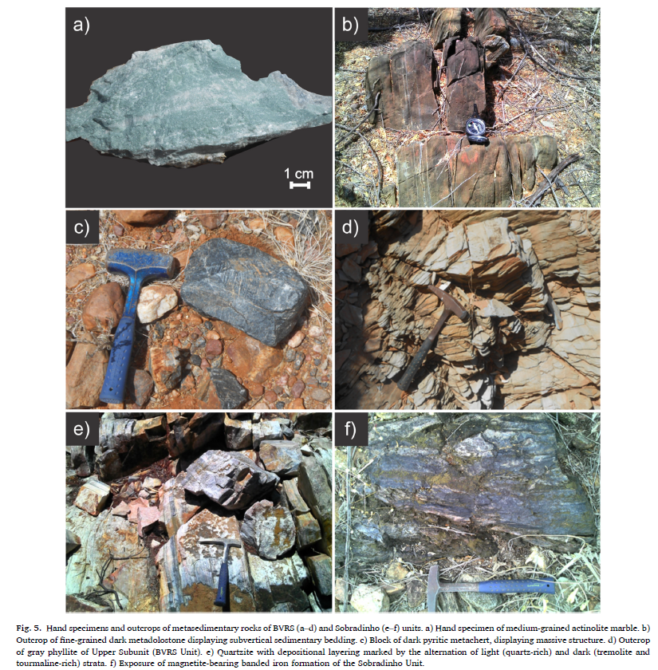
Metasediment Outcrops
b) Metadolostone
(showing bedding)
a) Actinolite Marble
d) Phyllite
c) Metachert
(pyritic massive)
e) Quartzite with depositional with light (quartz-rich) and dark (tremolite & tourmaline-rich) layers
f) Magnetite- bearing banded iron formation

Slide 52

Area of Interest (Northern Espinhaco & Chapada Diamantina)
Northern Espinhaco
Chapada Diamantina

Slide 53







Surface Geology / Quarries
Neoproterozoic (635 My – 1 By)
Morpara
Mesoproterozoic (1.0 By – 1.6 By)
Chapada Diamantina
Paleoproterozoic (1.6 By – 1.8 My)
Archaean (> 2.5 By)
Northern Espinhaco
Basic Intrusives (circa 850 My)
Oliveira dos Brejinhos
Ornamental Stone Quarries
Metacongolmerate Quarries

Slide 54





A bit of Brazil In Bath can be found at….
LHS

Slide 55


LHS
RHS

Slide 56
Extras….

Slide 57


Record of a Statherian rift-sag basin in the Central Espinhaço Range: Facies characterization and geochronology. Alice Fernanda de Oliveira Costa (2018)

Slide 58

Fig. 5. Lithofacies from FA1 association: (a) Massive matrix-to clast-supported conglomerate with disorganized framework; (b) layer of matrix-supported with scattered boulders; (c) layer of clast-supported conglomerate with angular clasts; (d) matrix-supported conglomerate separated by thin layers of sandstone (Sm).

Slide 59


Slide 60



E. G. de Souza (2019)

Slide 61

https://geoportal.cprm.gov.br/geosgb/
https://geosgb.cprm.gov.br/geosgb/index_en.html

Slide 62
THE END!

